Slide 1
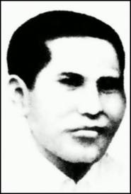
MUSIC PRESENTATION
Cornel Simanjuntak

Slide 2
Biography
He was born in 1921 on Pematangsiantar.
He was music composer
He got shoot by the Gurkha’s army
He composed some patriotic songs in the hospital
He died in yogyakarta in 15 september 1946 because of the tuberculosis

Slide 3
Contribution in war
He joined the army in 1945-1946 and fight against the Gurkha
Got injured by the Gurkha
Sent from Karawang to Yogyakarta
Made some patriotic songs that kept the army’s spirit high

Slide 4
Some of his songs
Tanah tumpah darah
Maju tak gentar
Pada pahlawan
Teguh kukuh berlapis baja
Indonesia tetap merdeka
The most popular one is maju tak gentar

Slide 5
Maju Tak Gentar Lyric
Maju tak gentar, membela yang benar. Maju tak gentar, hak kita diserang. Maju serentak mengusir penyerang. Maju serentak, tentu kita menang. Bergerak bergerak, serentak serentak, menerkam menerjang terjang. Tak gentar tak gentar, menyerang menyerang, majulah majulah menang.

Slide 6
About maju tak gentar
The tempo is 120, allegro.

